Slide 1

Relationships, Health and sex education
Bentley St Paul’s C of E Primary School
Parent consultation
June 2022

Slide 2

Relationship education: The view of the DfE
To embrace the challenges of creating a happy and successful adult life, pupils need knowledge that will enable them to make informed decisions about their wellbeing, health and relationships and to build their self-efficacy. Pupils can also put this knowledge into practice as they develop the capacity to make sound decisions when facing risks, challenges and complex contexts. Everyone faces difficult situations in their lives. These subjects can support young people to develop resilience, to know how and when to ask for help, and to know where to access support.
High quality, evidence-based and age-appropriate teaching of these subjects can help prepare pupils for the opportunities, responsibilities and experiences of adult life. They can also enable schools to promote the spiritual, moral, social, cultural, mental and physical development of pupils, at school and in society.
Relationships Education, Relationships and Sex Education (RSE) and Health Education Guidance, DfE, 2020

Slide 3
Aims of the consultation
To explain what the statutory requirements are for schools
To present the school’s policy and long term plan for RSE
To inform you of the non-statutory lessons that we propose to teach and why we propose to deliver them
To demonstrate how we intend to deliver RSE to children at Bentley St Paul’s

Slide 4
How will we deliver RSE at Bentley St Paul’s?
To be effective, RSE will:
Be age appropriate
Be based on the needs of the children
Be progressive, recapping and building on prior knowledge
Be inclusive
Be delivered by trained and knowledgeable staff in a safe environment
Prepare children adequately for puberty in a supportive and safe environment
Prepare children for adult life
Establish and agree basic ground rules that will be followed by children and the teacher
Promote positive relationships
Value all contributions

Slide 5
Relationships and Health education
From Summer term 2021 it became compulsory for all primary schools to deliver Relationships Education and Health Education lessons to children
Due to our change in PSHE scheme we have delayed our consultation and changes to our curriculum
Health Education has 8 core areas of learning:
  Mental well-being
  Internet safety and harms
  Physical health and fitness
  Healthy eating
  Drugs, alcohol and tobacco
  Health and prevention
  Basic first aid
  Changing adolescent body

Slide 6
Relationships education
RSE stands for: Relationships and Sex Education
Relationships Education has 5 core areas of learning:
  Families and people who care for me
  Caring friendships
  Respectful relationships
  Online relationships
  Being safe

Slide 7
Damian Hinds:
“This compulsory subject has been introduced to help to keep children safe; prepare them for the world in which they are growing up, including the laws as they relate to relationships, sex and health; to help foster respect for others and for difference.”
Damian Hinds – Secretary of State for Education, February 25th 2019

Slide 8
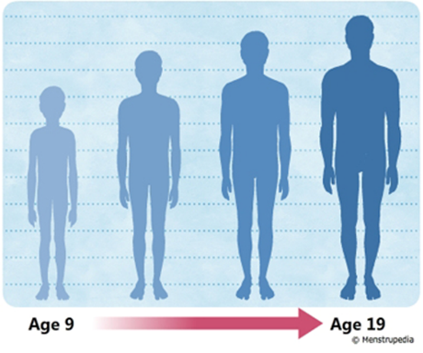
Relationships education
Relationships and Sex Education can also be found in the following Health Education units:
Mental Wellbeing
Internet safety and harms
Health and prevention
Changing adolescent body

Slide 9
Relationships & health education
Relationships Education | Health Education
Families and people who care for me | Mental Wellbeing
Caring friendships | Internet safety and harms
Respectful relationships | Physical health and fitness
Online relationships | Healthy eating
Being safe | Drugs, alcohol and tobacco
Non-mandatory Sex Education – children will have the ‘right to be excused’ | Health and prevention
 | Basic first aid
 | Changing adolescent body, including puberty
There is some cross over between relationships education and health education

Slide 10
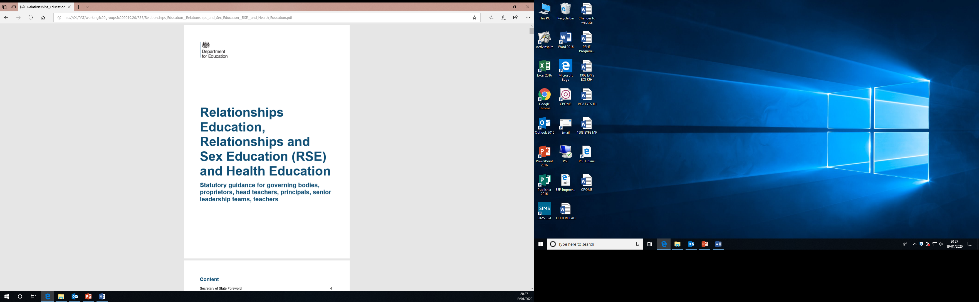
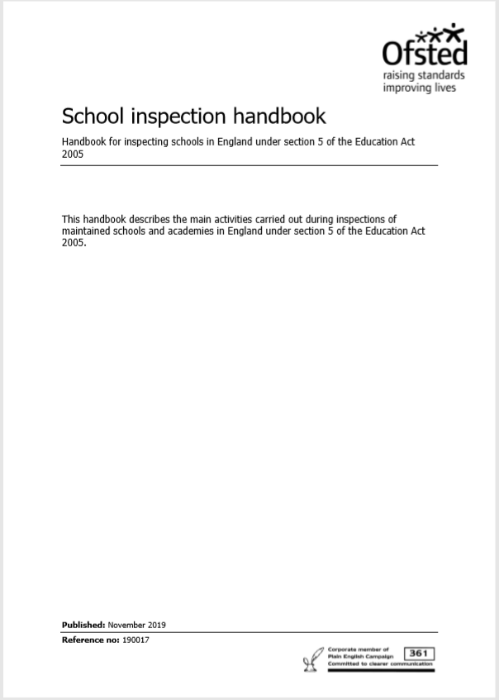
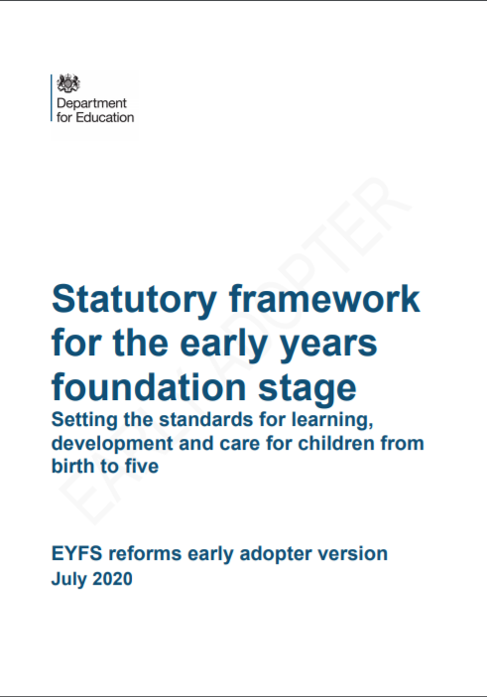
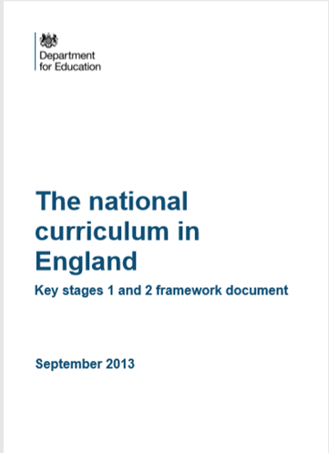
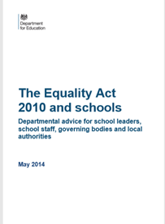
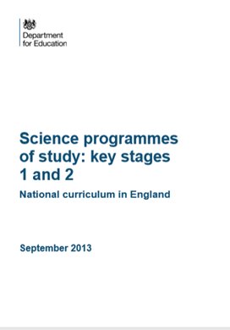
Some of the documents we use

Slide 11
EYFS – Where Relationships Education fits in…
Building relationships:
  Work and play cooperatively and take turns with others.
  Form positive attachments to adults and friendships with peers.
  Show sensitivity to their own and to others’ needs.
Managing self:
  Be confident to try new activities and show independence, resilience, and perseverance in the face of challenge.
  Explain the reasons for rules, know right from wrong and try to behave accordingly.
  Manage their own basic hygiene and personal needs, including dressing, going to the toilet, and understanding the importance of healthy food choices.
Self regulation:
  Show an understanding of their own feelings and those of others and begin to regulate their behaviour accordingly.
  Set and work towards simple goals, being able to wait for what they want and control their immediate impulses when appropriate.
  Give focused attention to what the teacher says, responding appropriately even when engaged in activity, and show an ability to follow instructions involving several ideas or actions.

Slide 12
EYFS – Where Relationships Education fits in…
The natural world
  Explore the natural world around them, making observations and drawing pictures of animals and plants.
  Know some similarities and differences between the natural world around them and contrasting environments, drawing on their experiences and what has been read in class.
  Understand some important processes and changes in the natural world around them, including the seasons and changing states of matter.

Slide 13
National Science Curriculum
Year 1 - Identify, name, draw and label the basic parts of the human body and say which part of the body is associated with each sense.
Year 2 - Notice that animals, including humans, have offspring which grow into adults.
Year 5 - describe the differences in the life cycles of a mammal, an amphibian, an insect and a bird.
Year 5 - describe the life process of reproduction in some plants and animals.
Year 5 - describe the changes as humans develop to old age. (They should learn about the changes experienced in puberty.)
Year 6 - recognise that living things produce offspring of the same kind, but normally offspring vary and are not identical to their parents.

Slide 14
Equalities Act 2010 and schools
9 - Protected characteristics - age, gender reassignment, being married or in a civil partnership, pregnancy or maternity, disability, race, religion or belief, sex, sexual orientation.
2.9 - schools are free to include a full range of issues, ideas and materials in their syllabus, and to expose pupils to thoughts and ideas of all kinds, however challenging or controversial, without fear of legal challenge based on a protected characteristic. Complaints against the content of the curriculum would not give rise to a valid complaint.
3.27 - Teaching should be based on facts and should enable pupils to develop an understanding of how the law applies to different relationships.

Slide 15
The RSE curriculum at Bentley St Paul’s will:
Be linked to the statutory National Curriculum and the EYFS framework
Adhere to the Equality Act 2010
Adhere to the Statutory RSE Guidance 2020
Reflect Ofsted expectations regarding tolerance and equality
Be focused on how to maintain positive friendships/relationships
Include some elements of sex education
Maintain our Christian ethos and teachings

Slide 16
Why will we teach sex education?
Children should know the correct terminology and vocabulary for their body parts. Children should know about their bodies and should be able to talk in confidence about what they are feeling / experiencing. This is especially crucial for safeguarding purposes.
As sex education is not compulsory, parents can choose to withdraw their child from sex education lessons.
The Science National Curriculum also teaches aspects of sex education – growing and changing, life cycles, reproduction. As this is part of the National Curriculum, this is compulsory. Parents cannot withdraw children from Science lessons.

Slide 17
The Government’s view on sex education
It is not compulsory for primary schools to teach sex education. However, we feel that it is important for children to know how their bodies change and develop.
It is important that the transition phase before moving to secondary school supports pupils’ ongoing emotional and physical development effectively. The Department continues to recommend therefore that all primary schools should have a sex education programme tailored to the age and the physical and emotional maturity of the pupils. It should ensure that both boys and girls are prepared for the changes that adolescence brings and – drawing on knowledge of the human life cycle set out in the national curriculum for science - how a baby is conceived and born.
Relationships Education, Relationships and Sex Education (RSE) and Health Education Guidance, DfE, 2020

Slide 18
Why is Relationships and Sex Education important?
Children should know that positive, caring and safe relationships are key
Puberty is starting earlier, for some children from the age of 8
To address any unwanted misconceptions that children may have
For safeguarding purposes:
  Grooming
  Child sexual exploitation
  Abuse
  Sexting
  Online pornography

Slide 19
Which are the optional areas?
Year 4 | My Changing Body – The statutory Health Education content covered in this lesson is also addressed elsewhere. The lesson is part of our optional Sex Education programme. The lesson explains how mammals (cats) grow babies (kittens) inside the mother’s womb or uterus. Mammal babies are made from 2 seeds; a female egg and a male sperm. The lesson explores what happens when the egg does not meet a sperm – the menstrual cycle. It links to: Changing adolescent body (Health Education) 1. Key facts about puberty and the changing adolescent body, particularly from age 9 through to age 11, including physical and emotional changes.
Year 5 | Is it True? – The lesson explores the idea of truth in an online context. The plenary considers gender, gender expression and gender identity. The plenary is optional content and a parent could request that their child is withdrawn from the plenary. It links to: Respectful Relationships, Online relationships, Being Safe (Relationships Education) and Internet Safety and Harms (Health Education)
Year 5 | Changing Bodies and Feelings – this lesson teaches the correct words for the male and female external sexual organs. It also gives the opportunity to discuss some of the myths associated with puberty. It links to: Changing adolescent body (Health Education) 1. Key facts about puberty and the changing adolescent body, particularly from age 9 through to age 11, including physical and emotional changes.

Slide 20
Which are the optional areas?
Year 6 | Making Babies – The statutory Relationships and Health content included in this lesson are covered elsewhere in the programme. This lesson is part of our optional content. The lesson will recap that the purpose of puberty is to prepare the body to reproduce. It explains conception through sexual intercourse. It explores the timeline of conception and pregnancy. It teaches legal facts about sexual intercourse. The lesson identifies other means of reproduction (including reference to same sex couples) including adoption, surrogacy and IVF. The lesson establishes that not every instance of sexual intercourse will result in a baby and talks briefly about contraception. It links to: Families and People who care for me, Being Safe (Relationships Education) and Changing adolescent body (Health Education)
Year 6 | What is HIV?– The lesson talks about illnesses and how they affect the immune system. The lesson then goes to talk about HIV and how it affects the immune system. This lessons links to the non-statutory Science content: pupils should learn how to keep their bodies healthy and how their bodies might be damaged including how some drugs and other substances can be harmful to the human body. It links to: Health and prevention (Health Education) 5. About personal hygiene and germs including bacteria, viruses, how they are spread and treated, and the importance of handwashing.

Slide 21
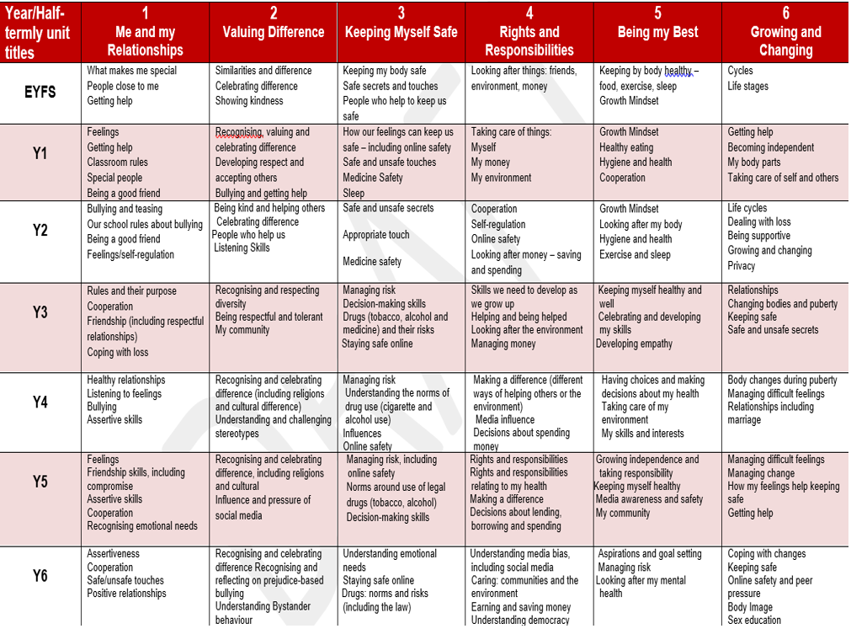
RSE Long term plan

Slide 22
How will we deliver RSE at Bentley St Paul’s?
To be effective, RSE will:
Be age appropriate
Be based on the needs of the children
Be progressive, recapping and building on prior knowledge
Be inclusive
Be delivered by trained and knowledgeable staff in a safe environment
Prepare children adequately for puberty in a supportive and safe environment
Prepare children for adult life
Establish and agree basic ground rules that will be followed by children and the teacher
Promote positive relationships
Value all contributions

Slide 23
Examples of resources: Reception
Reception content
Seasons and change
Life stages in plants, animals and humans
Where do babies come from?
Getting bigger
Me and my body
Looking after my special people
Looking after my friends
Sample Learning Activities
Role-play how you can help your special people at home
Read a book together about getting bigger
Using the pairs cards, match up the baby animal with its adult equivalent
Invite a midwife in to talk about her job
Draw pictures of a friend. At the bottom of the picture write how they look after that friend or how their friend looks after them

Slide 24
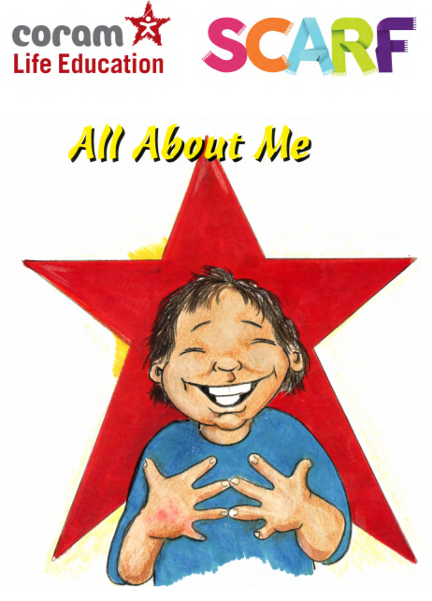
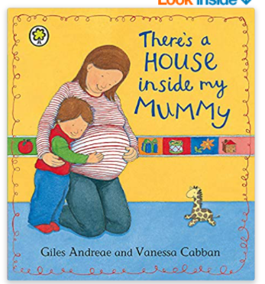
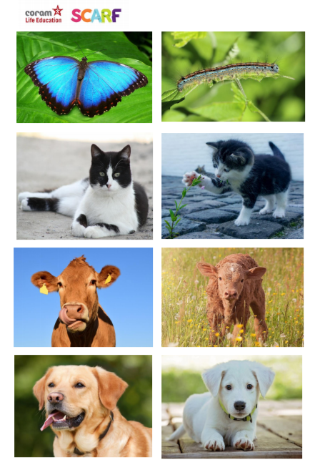
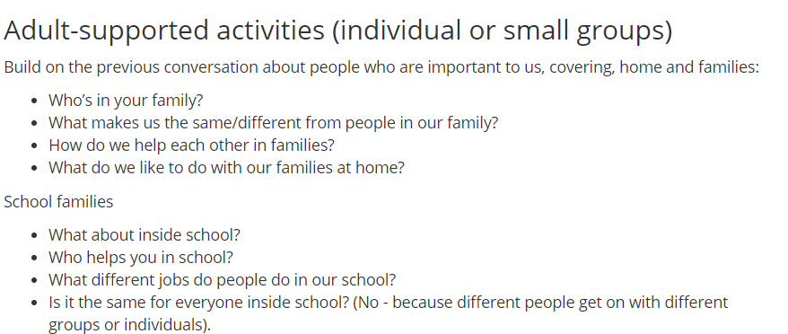
Examples of resources: Reception
Where do babies come from? Me and my special people

Slide 25
Examples of resources: Year 1
Extending learning from Reception
New content includes:
  Our special people
  Caring behaviour
  Respecting others
  Safe touch
  Unsafe secrets
  Friendship
  Communication
  Bullying
  Boundaries
  Privacy including naming genitals
  Feelings
Sample Learning Outcomes
Recognise and name some of the qualities that make a person special to them
Identify simple qualities of friendship
Identify things they could do as a baby, a toddler and can do now
Explain the difference between appropriate and inappropriate touch
Identify who they can talk to if they feel uncomfortable about any secret they are told, or told to keep
Identify parts of the body that are private

Slide 26
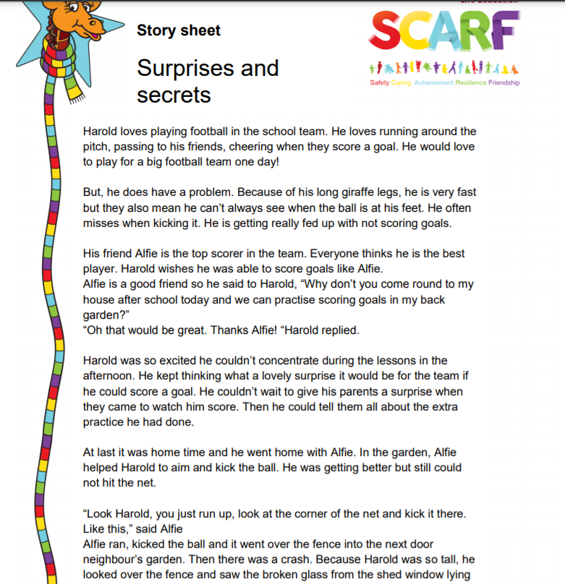
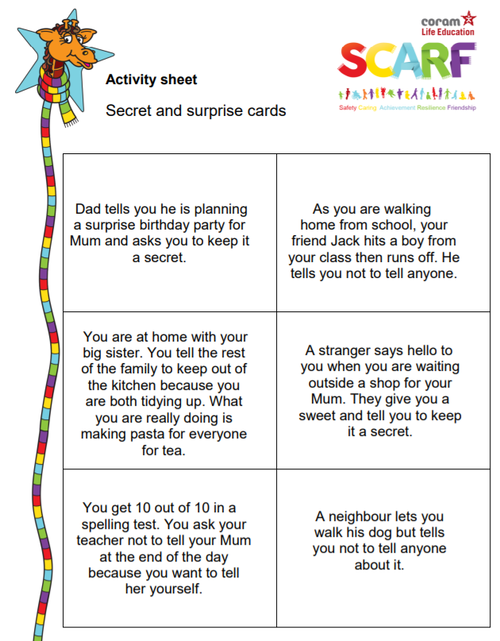
Examples of resources: Year 1
Surprises and secrets
Children will be able to:
-Explain the difference between a secret and a nice surprise;
-Identify situations as being secrets or surprises;
-Identify who they can talk to if they feel uncomfortable about any secret they are told, or told to keep.

Slide 27
Examples of resources: Year 2
Extending learning in year 1.
New content to include:
How my behaviour (positive or negative) affects others
Becoming more independent
Keeping themselves and others safe
Growing from young to old and how people’s needs change
Sample Learning Outcomes
Identify some of the ways that good friends care for each other
Know and use words and phrases that show respect for other people
Explain where someone could get help if they were being upset by someone else’s behaviour
Identify situations in which they would need to say 'Yes', 'No', 'I'll ask', or 'I'll tell', in relation to keeping themselves and others safe.
Identify the types of touch they like and do not like
Explain that our genitals help us make babies when we are older

Slide 28
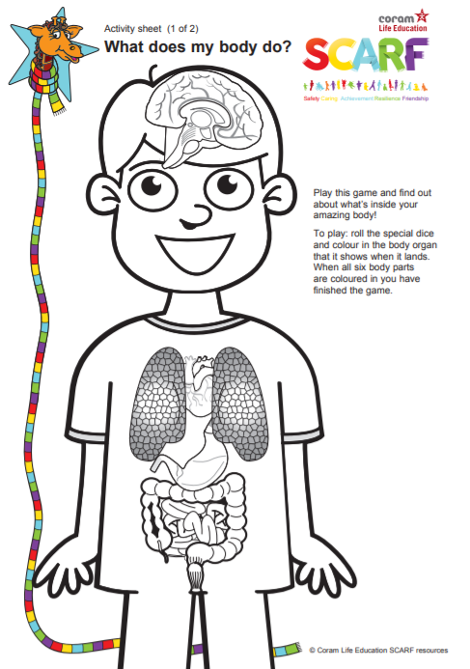
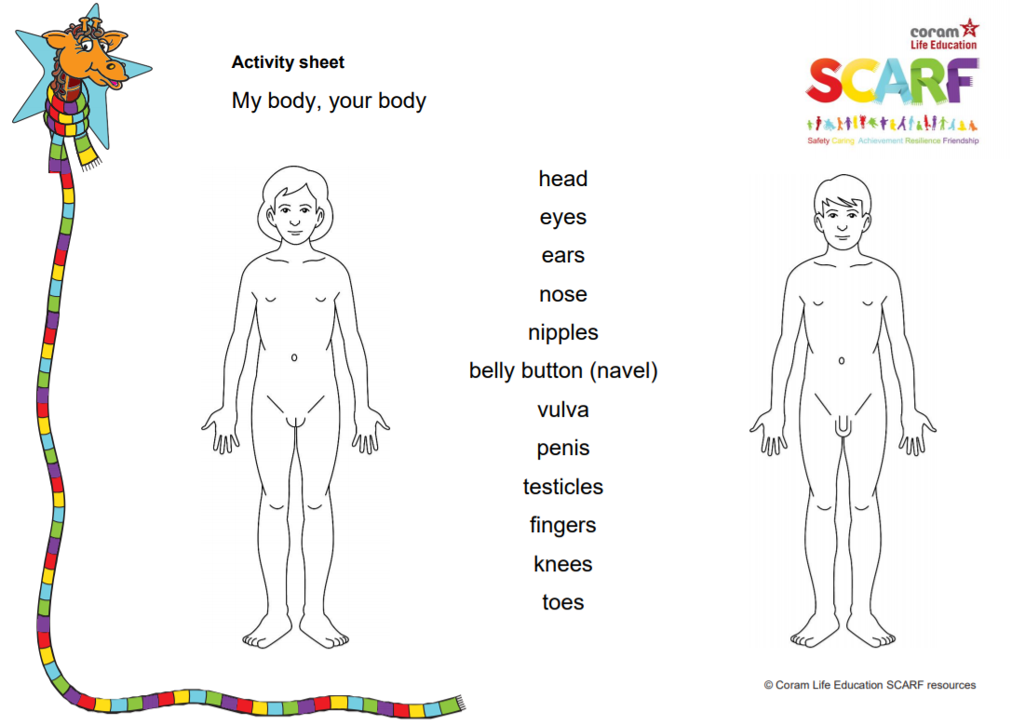
Examples of resources: Year 2
My body, your body What does your body do?
Children will be able to:
-Identify which parts of the human body are private
-Understand that humans mostly have the same body parts but that they can look different from person to person
Children will be able to:
-Name major internal body parts (heart, blood, lungs, stomach, small and large intestines, brain);
-Describe how food, water and air get into the body and blood.

Slide 29
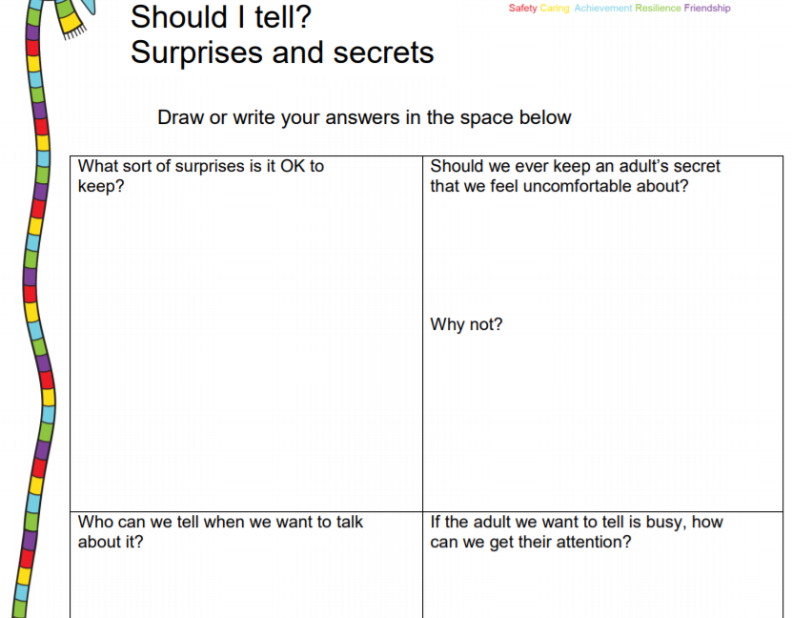
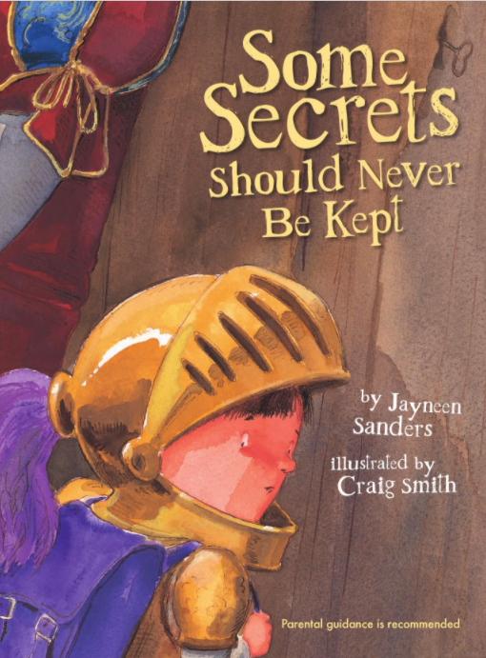
Examples of resources: Year 2
Should I tell? Some secrets should never be kept
Children will be able to:
-Identify safe secrets (including surprises) and unsafe secrets;
+Recognise the importance of telling someone they trust about a secret which makes them feel unsafe or uncomfortable.
Children will be able to:
Identify how inappropriate touch can make someone feel;
Understand that there are unsafe secrets and secrets that are nice surprises;
Explain that if someone is being touched in a way that they don’t like they have to tell someone in their safety network so they can help it stop.
The book is aimed at 3-12 year old children and is intended to give them skills to deal with inappropriate touch.

Slide 30
Examples of resources: Year 3
Extending learning in year 2.
New content to include:
Change including bereavement
Images in the media
Protecting personal information online
Different types of relationships
Healthy and unhealthy relationships (friendships),
Discrimination and its consequences
Understanding risk
Making informed choices
Resisting pressure
Sample Learning Outcomes
Explain some of the feelings someone might have when they lose something important to them
Recognise and describe appropriate behaviour online as well as offline
Identify when it is appropriate or inappropriate to allow someone into their body space
Recognise who they have positive healthy
relationships with
Recognise that repeated name calling is a form of bullying

Slide 31
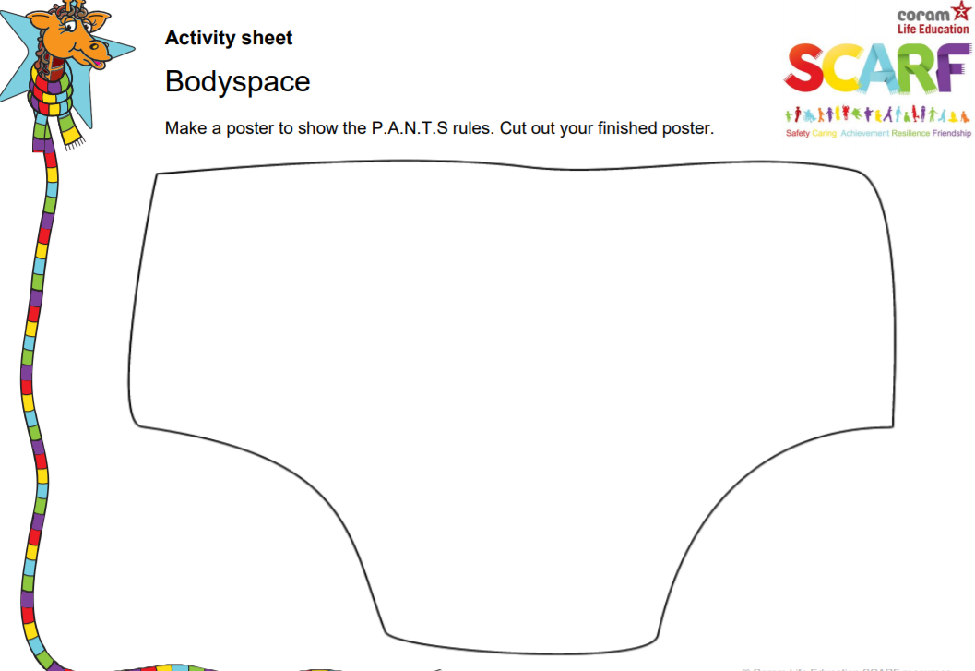
Examples of resources: Year 3
Body space
Children will be able to:
-Understand what is meant by the term body space (or personal space);
-Identify when it is appropriate or inappropriate to allow someone into their body space;
-Rehearse strategies for when someone is inappropriately in their body space

Slide 32
Examples of resources: Year 4
Extending learning in Y3
New content to include:
  Body changes in puberty
  Menstruation
  Conflicting emotions
  Good and not so good feelings
  Marriage and other relationships
  Consequences of our actions
  Recognise and challenge stereotypes
  Pressures to behave in an unacceptable, unhealthy or risky way
Sample Learning Outcomes
Understand and explain why puberty happens
Suggest reasons why young people sometimes fall out with their parents
Discuss the reasons why a person would want to be married, or live together, or have a civil ceremony
Define what is meant by 'being responsible‘
Understand and identify stereotypes, including those promoted in the media
Understand that we can be influenced both positively and negatively

Slide 33
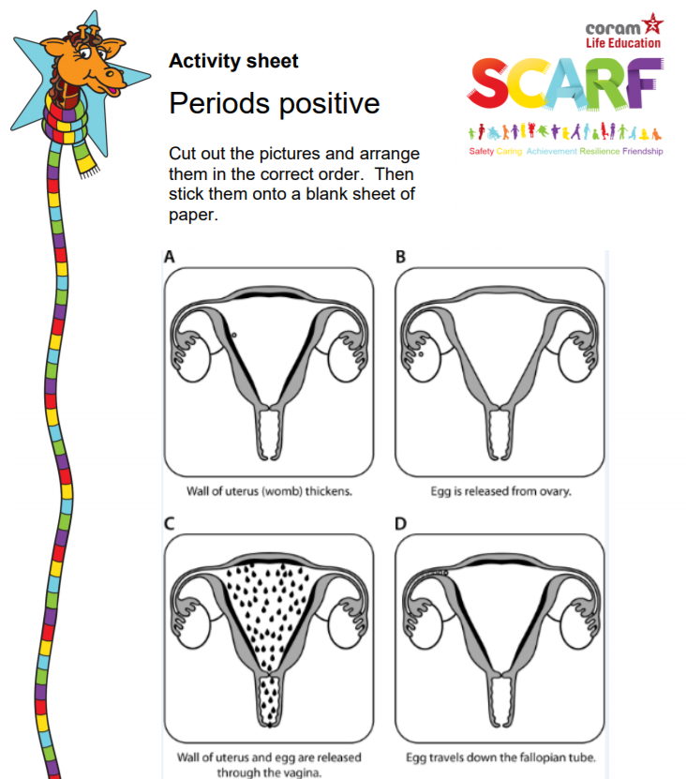
Examples of resources: Year 4
My changing body
Children will be able to:
-Recognise that babies come from the joining of an egg and sperm;
-Explain what happens when an egg doesn’t meet a sperm;
Understand that for girls, periods are a normal part of puberty.

Slide 34
Examples of resources: Year 5
Sample Learning Outcomes
Identify some products that they may need during puberty and why
Understand that for girls, periods are a normal part of puberty
Recognise some of the feelings associated with feeling excluded or ‘left out’
Identify what things make a relationship unhealthy
Explore and share their views about decision making when faced with a risky situation
Recognise that people aren’t always who they say they are online
Recognise that some people can get bullied because of the way they express their gender
Know how to protect personal information online
Extending learning in Y4
New content to include:
  Body changes and feelings during puberty
  Changing feelings and the effect on those we live with
  Unhealthy relationships
  Risky behaviour
  Using social media safely
  Types of bullying including homophobic
  Keeping personal information private online

Slide 35
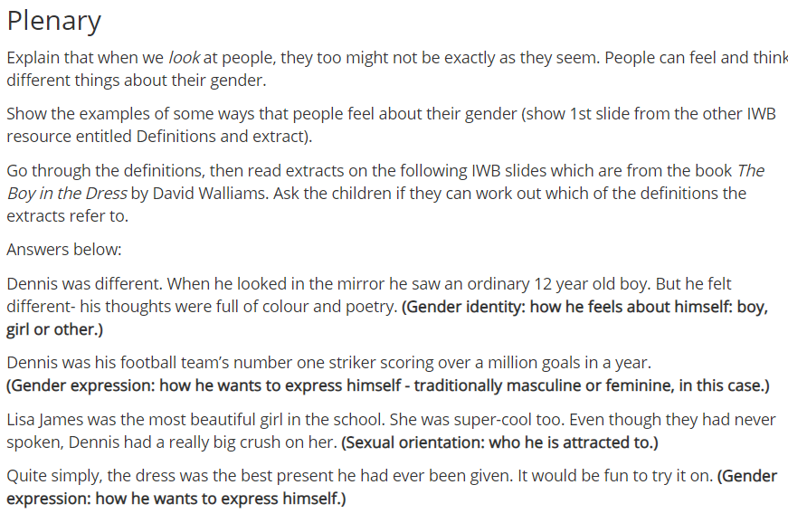
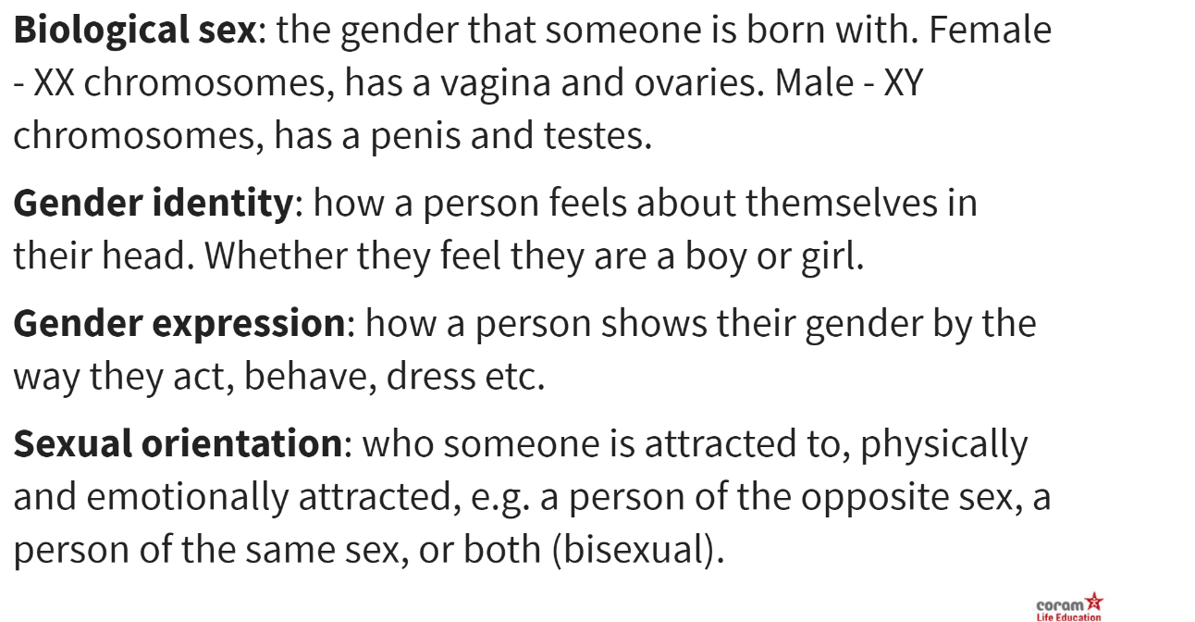
Examples of resources: Year 5
Is it true? Please note this is non-statutory
Children will be able to:
-Understand that the information we see online, either text or images, is not always true or accurate;
-Recognise that some people post things online about themselves that aren’t true, sometimes this is so that people will like them;
-Understand and explain the difference between sex, gender identity, gender expression and sexual orientation.

Slide 36
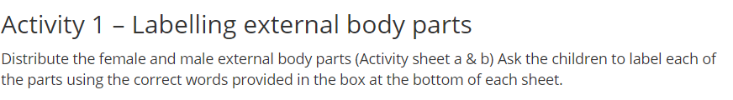
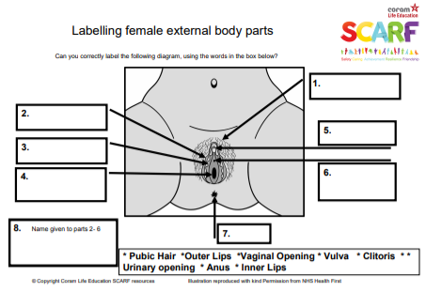
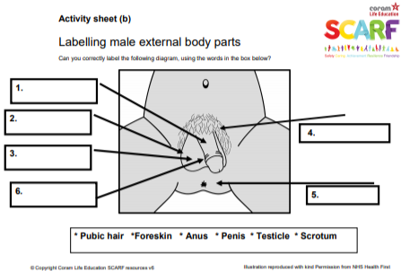
Examples of resources: Year 5
Changing bodies and feelings Please note that this is non-statutory
Children will be able to:
-Know the correct words for the external sexual organs;
-Discuss some of the myths associated with puberty.

Slide 37
Examples of resources: Year 6
Sample Learning Outcomes
Recognise that photos can be changed to match society's view of perfect
Explore the risks of sharing photos and films of themselves with other people directly or online
Describe ways in which people show their
commitment to each other
Know a variety of ways in which the sperm can fertilise the egg to create a baby
Explain how HIV affects the body’s immune system (non-statutory)
Extending learning in Y5
New content to include:
  Body image
  Sharing images online
  Forced marriage
  Conception, reproduction & birth
  HIV (non-statutory)

Slide 38
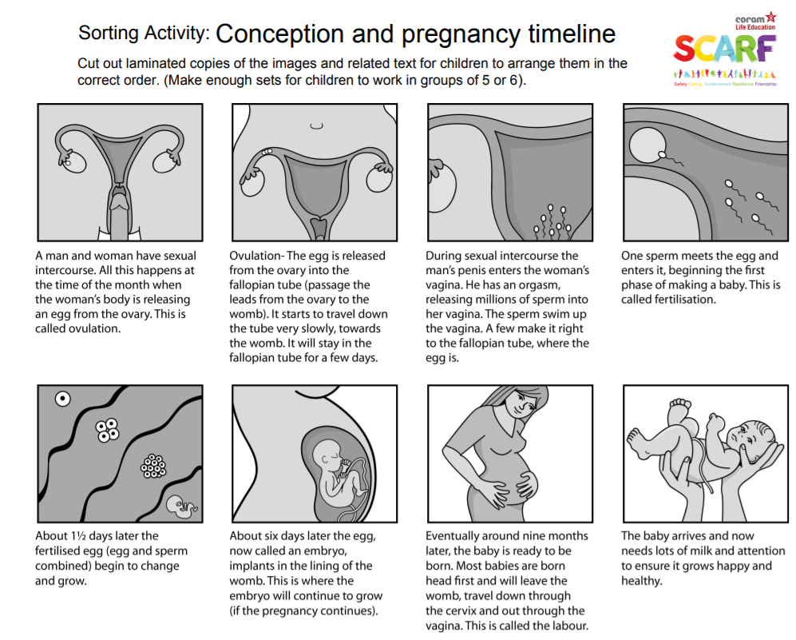
Examples of resources: Year 6
Making babies Please note this lesson is non-statutory
Children will be able to:
-Identify the changes that happen through puberty to allow sexual reproduction to occur;
-Know a variety of ways in which the sperm can fertilise the egg to create a baby;
-Know the legal age of consent and what it means.

Slide 39
The consultation process
So far, we have shared our proposed long term plan and policy with Governors and with staff.
Now we are asking parents for constructive advice and feedback on the proposed policy and school plans to deliver the RSE curriculum.
All feedback will be considered and questions will be answered.
There are further documents on the school website: Curriculum – RSE. Here you will find the RSE policy, the long term plan and Government guidance both for schools and parents.

Slide 40
Summary
Parents have the right to withdraw children from Sex Education lessons that are not part of the statutory Science and statutory Relationships and Health Education (the optional parts that we will teach)
Schools have the right and obligation to teach RSE topics to prepare children for life when they leave primary school.
You can view our RSE policy on our website: Curriculum - RSE

Slide 41

Any questions?

